Slide 1

OverGen: An End-to-end Full-Stack Infrastructure for Domain-Specific Accelerator Research
Sihao Liu, Jian Weng, Dylan Kupsh, Tony Nowatzki
University of California, Los Angeles
PolyArch Research Group
Oct 2nd, 2022; 55th MICRO Tutorial
Notes:
Good afternoon everyone, this is Jian Weng, a 6th-year Ph.D. student advised by Prof. Tony Nowatzki.
Welcome to our tutorial, ... .
You may also notice the logo on the flash, which is DSAGEN.
It was our first paper on programmable accelerator research infra, published 2 years ago.
OverGen is our SOTA work built on the top of DSAGEN, which is accepted by the main conference program.
Do not miss out our presentation on the best paper session.
My collaborator Sihao will make his first conference show.

Slide 2
Resources
Tutorial Website
https://dsa-framework.readthedocs.io/en/latest/Tutorial/index.html
Setup Procedure
https://dsa-framework.readthedocs.io/en/latest/Basics/Setup.html
From Dockerfile/From Prebuilt Binaries
SSH to our clustered server
Released Source: https://github.com/PolyArch/dsa-framework
Hands-on Examples: https://github.com/PolyArch/dsa-apps
Notes:
Before starting, I want to make sure everyone is on-board.
We have different ways of distributing the tutorial infrastructure, including downloading from the website and copy-paste prebuilt binaries from the flash disk.
If you haven’t installed it on your machine, please raise your hands so that my collaborators will help you.
If you would like to setup everything from source code for your own research after, feel free to access our public github repo.
All our examples we go through in this tutorial are available in the subrepo dsa-apps.
After this tutorial, all these slides will also be uploaded for recapping.

Slide 3
Access our Server
SSH to our Server
ssh micro2022@pyrito.cs.ucla.edu # password: micro2022
ssh [user-name]@micro2022
User Name: user[1-50]
Password: [random-generated]
Wait to be assigned
Sanity Check
$ dsa-framework
$ source setup.sh # We are already on zsh!
$ cd dsa-apps/sdk/compiled
$ ./run.sh ss-vecadd.out
If you see the message below, the infra is setup properly
Notes:
Before starting, I just want to make sure everyone is on-board.
If so, you can try the command above to see if it works.
In the rest of this section, I will explain what happens in this run.sh script.

Slide 4
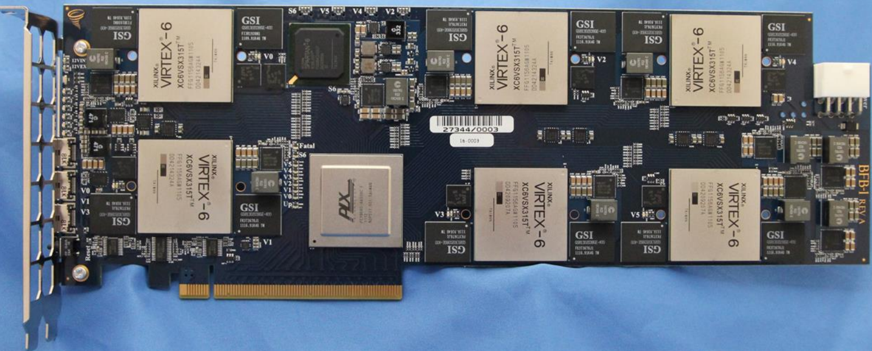
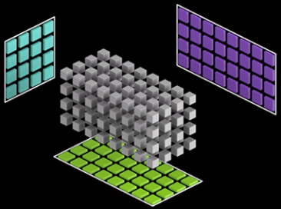

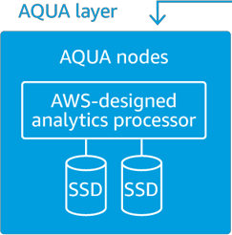
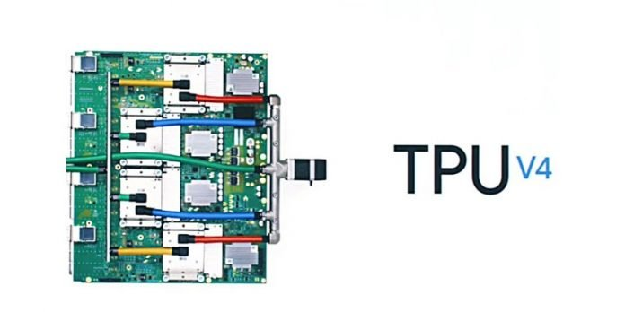
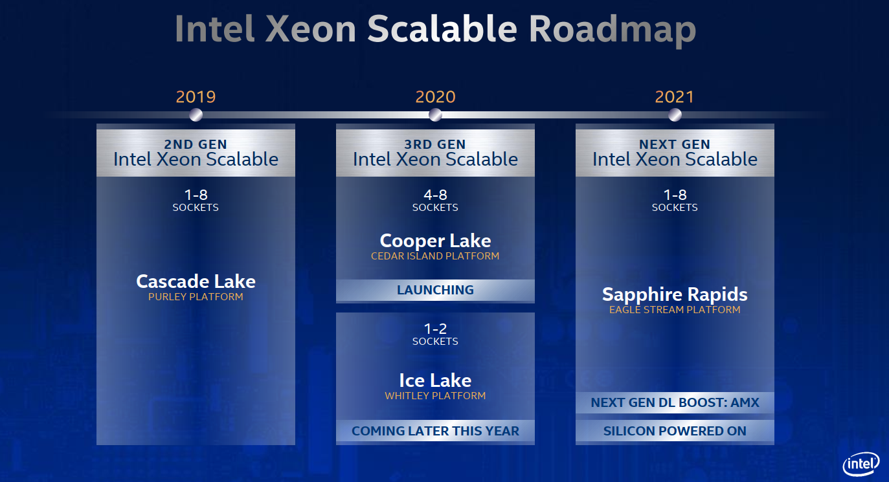
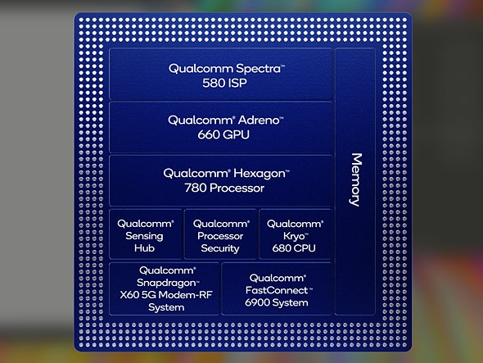
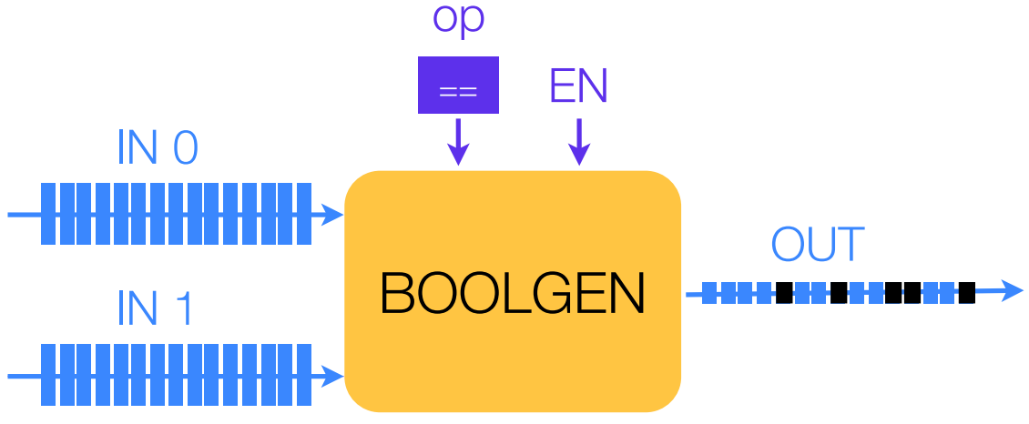
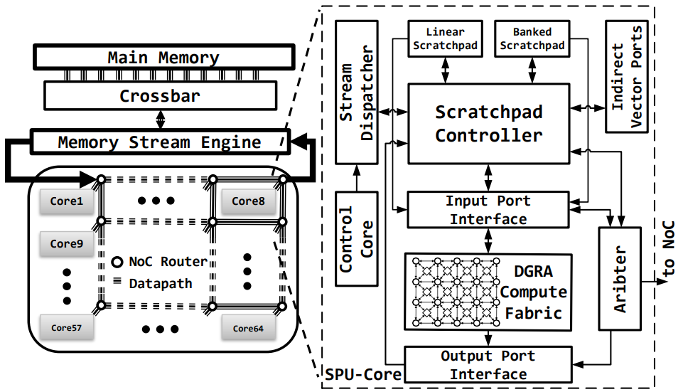
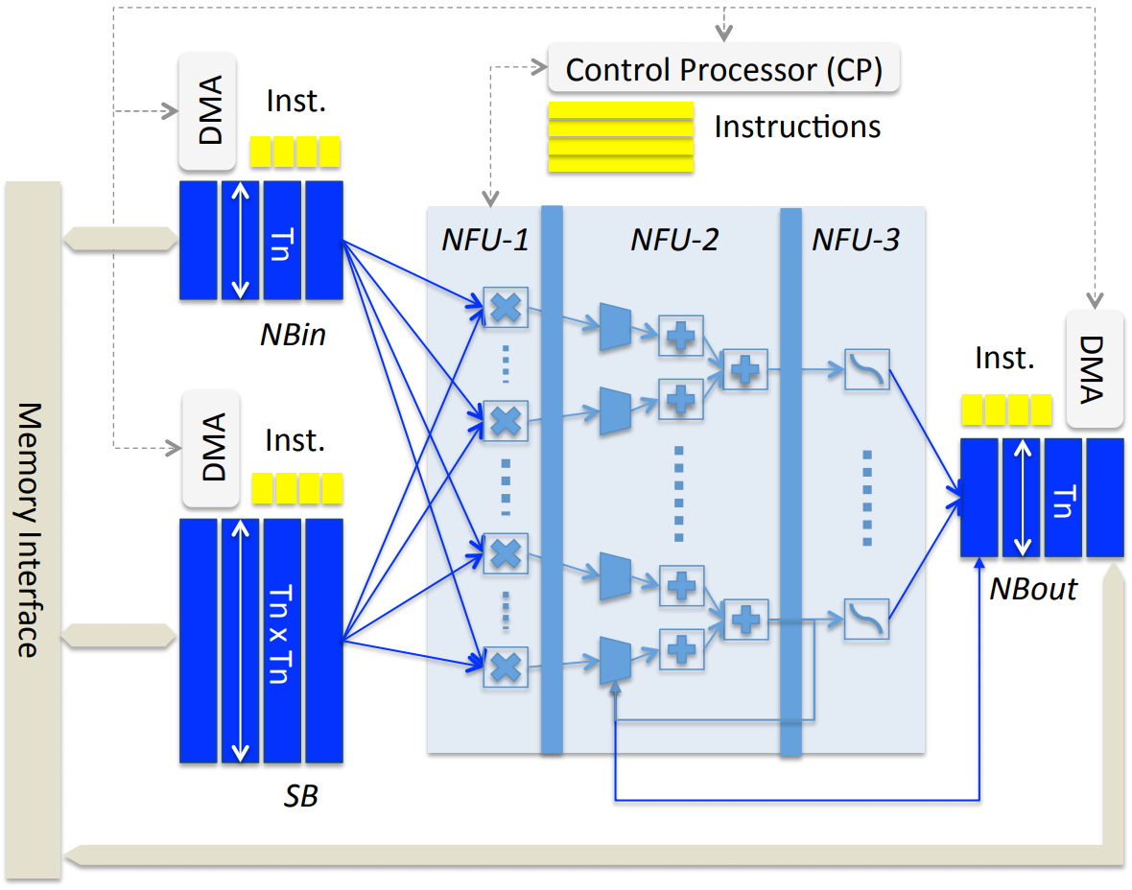
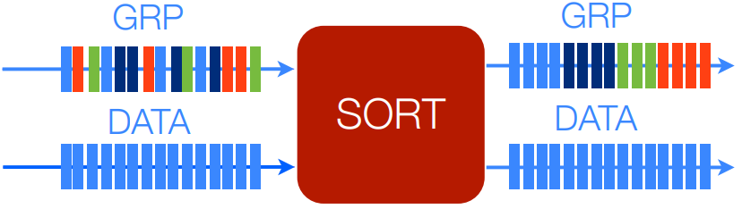
Specialized accelerators are the answer!
Increasing number of specialized blocks on SoC’s
Accelerators by cloud service provider & hardware vendor
Microsoft - BFB Board
Nvidia TensorCore
Apple A15
Amazon AQUA
Google TPUv4
Intel VNNI/AMX
Accelerators by academics
QualComm Snapdragon 888
Diannao ISCA’14
Q100 ASPLOS’14
SPU MICRO’19
Notes:
So much for the infrastructure setup, and let’s start!
The motivation of this project is pretty straight forward.
Because of the wanning benefit of transistor scaling, specialized accelerators emerge, and already achieve big success in both academics and industry.
For example, during the past decades, both Apple and QualComm are increasing the number of specialized blocks in their SoC for better perf/energy ratio.
These specialized accelerators targeting image processing, graphics, video and audio decoder and encoder, and wireless signal processing.
Moreover, both cloud service providers and hardware vendors have developed their own specialized accelerators, not only for NN models, but also for db query.
Similar thing in academics.
So how are these accelerators designed?

Slide 5

Domain-Specific Accelerator Design
Program Behavior of Interest
Program Behavior of Interest
Detect program idioms
Encode them in ISA
Detect program idioms
Knowledge on hardware specialization
Hardware Specialization
Compiler
Domain-Specific ISA
Apps
Manual Design /
Trial and Error
Programmable Accelerator
RTL
Sw/hw Affinity
Evaluation
Notes:
Designing a domain-specific architecture starts with a set of target applications.
Then the developers study the program behaviors of interest and use their knowledge to develop specialized hw mechanisms. They are implemented and evaluated.
Since it is a programmable design, the sw/hw interfaces should be considered, and then high-level abstraction, and the compilation techniques.
It is human-effort-intensive. Is it possible to automate?
By studying the process, we extract the insights.

Slide 6
Insights and Principles behind DSAGEN
Idiomatic Design
Application domains do not define an accelerator.
👉 Computing behaviors of interests (idioms) do.
Modularity (Define the design space)
Each idiom-specialized feature should be combinable.
👉 Hardware and compilation should be modularly flexible.
Generality and Performance
Avoid Von-Neumann overheads while retaining generality.
👉 Decoupled-Spatial Paradigm
Notes:
Our insight is that, actually, application domains do not define an accelerator design, but programming behaviors of interests do.
And later, we will call the behaviors of interests idioms.
Compiler best understands these idioms. Therefore, the compiler not only bridges the software ISA and hardware execution model, but also uses this knowledge to guide hardware design.
Before exploring the design space, we should make the design space well defined. The principle of formalizing the design space is that each specialized feature can be independently integrated to the candidate hardware.
Last but not the least, though our framework generates domain-specific accelerators, the target domain is agnostic. Therefore, our universal set should be general-purpose.
Among all the accelerator design paradigms, the decoupled spatial paradigm is especially attractive to us, and will be explained later.

Slide 7
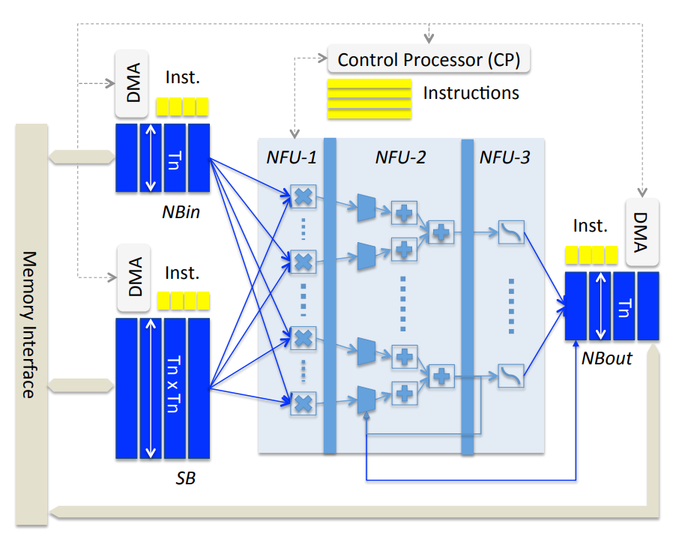
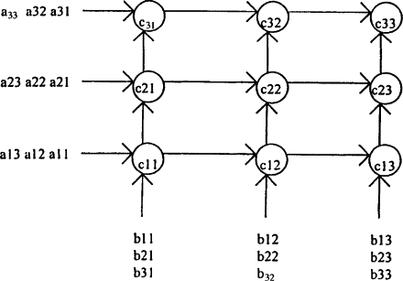
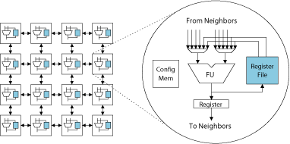
Spatial Architectures
Spatial Layout of PE, Memory and N/w
Flexible Topology
Programmable Software Pipeline

Slide 8
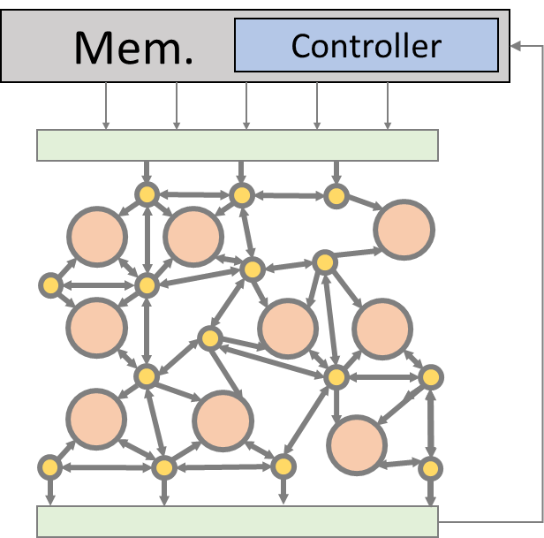
DSAGEN: Decoupled-Spatial Architecture Generation
Domain-Specific
C/C++
Kernels
(pragmas)
LLVM +
Dataflow Compiler
Compiled
RISCV+Accel
Binaries
DRAM
Compile
LLC
Network-on-Chip
Design-space
Exploration
Runs on
RISCV CPU
RISCV CPU
RISCV CPU
Automating Specialized Accelerator Design
Memory
Acce.
Acce.
Sys. Params.
#cores
Net. b/W
Cache Banks
RTL Generation
Chisel-based
Hardware Generator
Rec Bus
Arch. Desc. Graph (ADG)
Notes:
Based on the insights and principles mentioned just now, we present the framework DSAGEN.
Starting with a set of applications written in C with pragma annotated, we want to generate a specialized accelerator for them.
We break this goal down into steps. We feed these apps to a compiler that understands the program idioms and hardware mechanisms to extract the knowledge on hardware feature demands by applying different subset of the transformations on the software and generate multiple versions of IR.
Then these extracted knowledge will be used to co-optimize the software and hardware.
We will evolve the underlying hardware guided by evaluating the software/hardware affinity, which will be explained by my collaborator Dylan Kupsh in his analytical model section.
We will select the most proper version and map them to the underlying hardware.
This process iteratively repeats, and finally when it converges, we get the optimized sw/hardware pair.

Slide 9
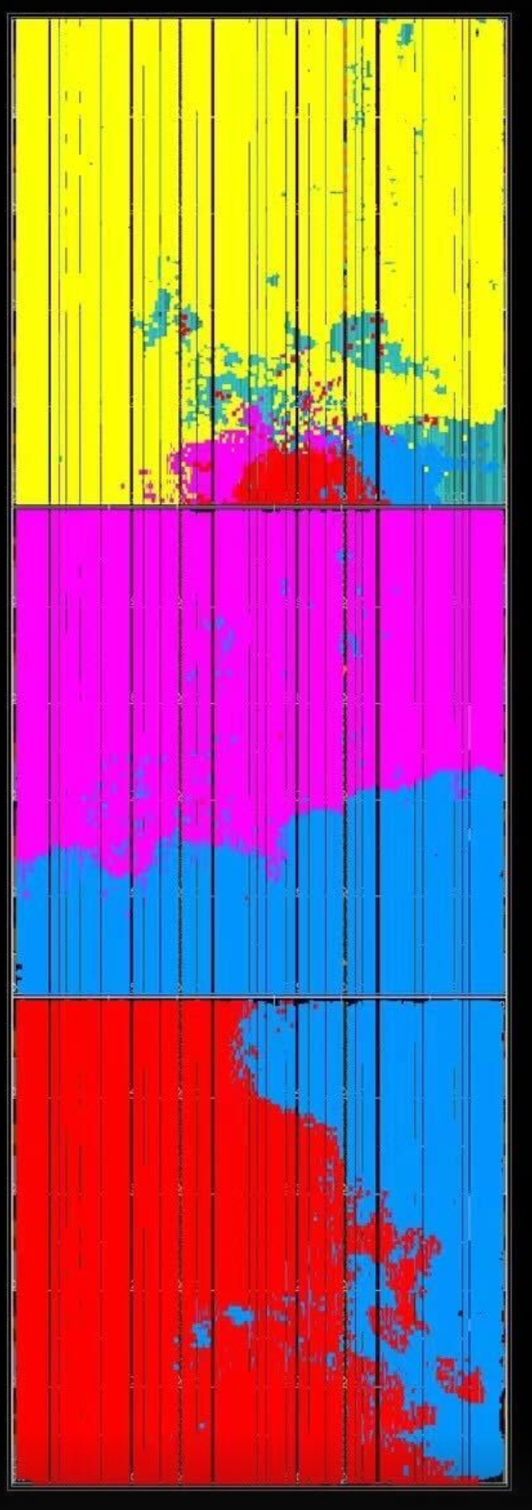
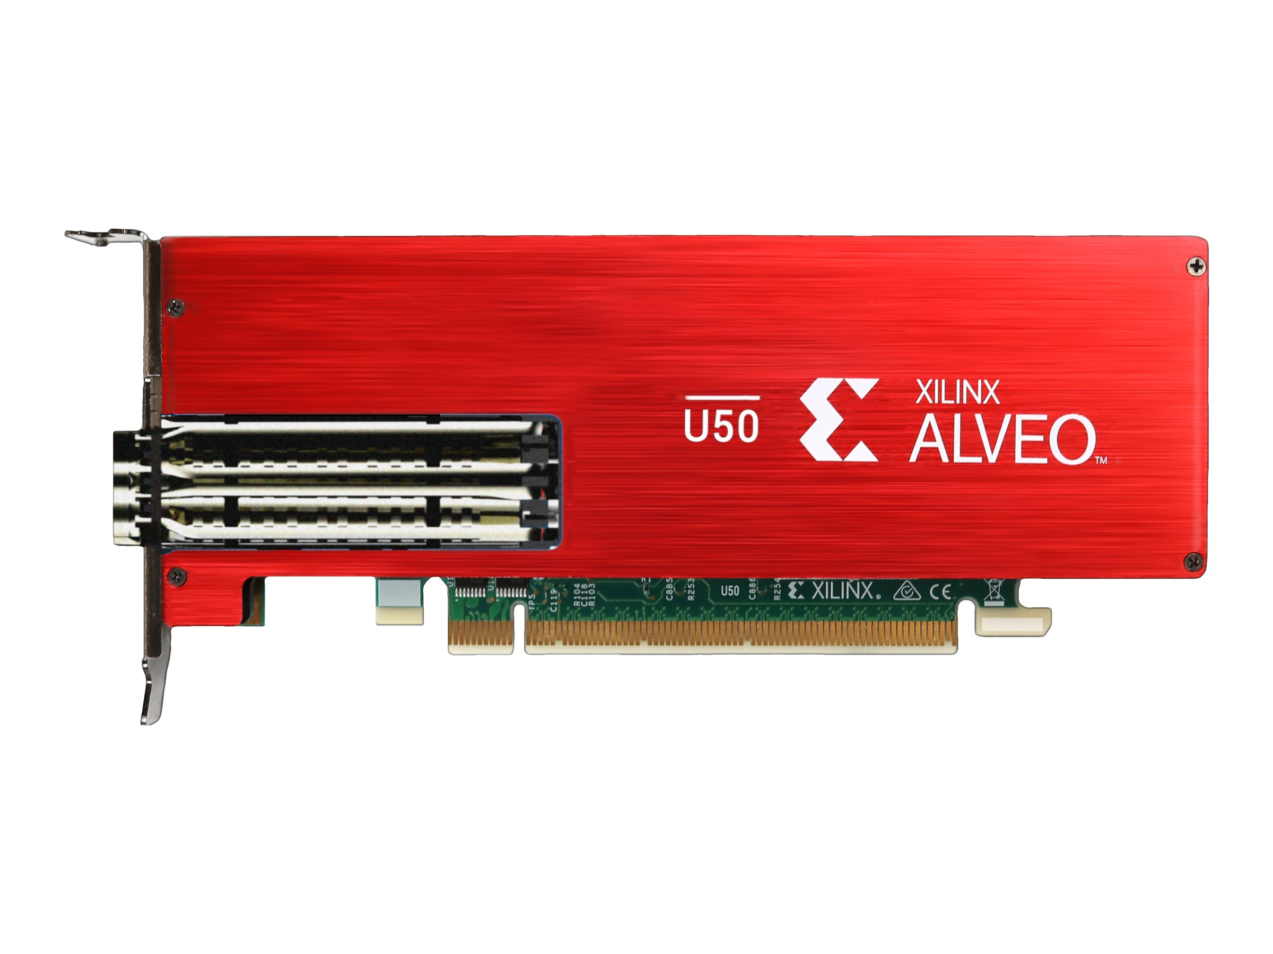
OverGen: Specialized Overlay for FPGA Programming
SoC Integration by ChipYard
C/C++
Kernels
(pragmas)
LLVM +
Dataflow Compiler
Compiled
RISCV+Accel
Binaries
DRAM
Compile
LLC
Network-on-Chip
Design-space
Exploration
Runs on
RISCV CPU
RISCV CPU
RISCV CPU
Memory
Acce.
Acce.
Sys. Params.
#cores
Net. b/W
Cache Banks
Physical Design
RTL Generation
Chisel-based
Hardware Generator
Rec Bus
Arch. Desc. Graph (ADG)
FPGA
Notes:
And also, we fined that this approach is especially useful to improve the usability of FPGA.
The generated accelerator can be mapped on to FPGA as another level of overlay. This is the big idea of our OverGen paper.

Slide 10
High-Level Synthesis
Each app takes hours
App-specific design
~ms to reconfig FPGA
HLS Tool
C/C++
Kernels
(pragmas)
C/C++
Kernels
(pragmas)
C/C++
Kernels
(pragmas)
S2S DSE
Translate to RTL
Synthesis
Placement & Routing
C/C++
Kernels
(pragmas)
S2S DSE
Translate to RTL
Synthesis
Placement & Routing
S2S DSE
Translate to RTL
Synthesis
Placement & Routing
FPGA
S2S DSE
Translate to RTL
Synthesis
Placement & Routing
Our Approach
+ Common efforts saved
+ Reconfigurable Design
+ ~cycles to reconfig CGRA
C/C++
Kernels
(pragmas)
Compiler Xform
C/C++
Kernels
(pragmas)
C/C++
Kernels
(pragmas)
Compiler Xform
C/C++
Kernels
(pragmas)
Compiler Xform
Compiler Xform
Compiler Xform
SW/HW DSE
RTL Gen.
Synthesis
P&R
Compiler Xform
Compiler Xform
Compiler Xform
FPGA
Notes:
By doing this, we have two major benefits:
A set of applications are specialized at once, which saves significant amount of common efforts to synthesize RTL and explore the physical design.
Conventional HLS generates one application-specific design for each program, which lacks flexibility. It takes an order of ms to reconfigure to switch across applications, and needs to re-go through this long process when a two line-change happens.

Slide 11
Roadmap
Motivation
Background
Decoupled-Spatial Execution
Related Works
Design Space
Framework Overview
Notes:
OK. So much for the motivation, here we come to more details. I will first explain what is decoupled-spatial, and transit to the design space.

Slide 12
Decoupled-Spatial Paradigm: Spatial Architecture
Controller
for (int i = 0; i < n; ++i)
c[i] += a[i] * b[i];
Memory
Mem. Controller
A
B
C
Sync. FIFO
(Ports)
A
B
C
1
1
1
×
2
2
2
×
＋
3
3
4
4
＋
Processing Elements
5
D
6
7
Switches
D
Notes:
To explain the decoupled-spatial paradigm, let’s go through a simple example.
For a piece of code, the memory access and computations are decoupled and specialized respectively.
The computations are represented in a data flow graph and mapped onto a spatial architecture. Spatial architecture typically refers those architectures are consist of PEs for performing computations connected by on-chip network composed by switches for routing the dependences, and synchronization FIFOs which not only serves as an interface of the operands but also coordinates a timing of data issue and instruction execution.
This mapping is encoded in a bitstream. The controller issues commands to the spatial architecture to load the bitstream.

Slide 13
Decoupled-Spatial Paradigm: Decoupled Memory Access
Ctrl Host
Controller
SRAM/DRAM
for (int i = 0; i < n; ++i)
c[i] += a[i] * b[i];
Address Generator
Memory
Mem. Controller
a[0:n]
b[0:n]
c[0:n]
Mem. Access:
A
B
C
×
a[0:n]
A
×
＋
b[0:n]
B
c[0:n]
C
＋
c[0:n]
D
c[0:n]
D
Notes:
The memory access are encoded in control intrinsics issued from the control host to the memory controller. Then the memory controller sends memory request so that the data can stream through the spatial architecture to execute the program.
Under this paradigm, as long as the data access can be sustained, the graph execution instances can be fully pipelined to maximize the instruction level parallelism, which is the main source of performance gain.

Slide 14
Decoupled-Spatial Paradigm: Summary
for (int i = 0; i < n; ++i)
c[i] += a[i] * b[i];
RISCV-Core
main:
li $rs3, 0
loop:
load $rs1, a[i]
load $rs2, b[i]
mul $rs1, $rs1, $rs2
load $rs0, c[i]
add $rs0, $rs1
store $rs1, c[i]
add $rs3, $rs3, 1
blt $rs3, n, loop
main:
...
load config
a[0:n] -> A
b[0:n] -> B
c[0:n] -> C
D -> c[0:n]
barrier
Memory
Mem. Controller
A
B
C
×
＋
+ Simpler PE, better memory b/w utilization
- Different execution model for comp. and mem.
D
Notes:
Specific to our implementation, the host controller is a light-weighted single-issue riscv-core, so programming a decoupled-spatial architecture is essentially encode and embed these specialized program idioms in the RISCV assembly code. This can be done either manually embed the assembly code in the von-neumann program or transformed by a compiler.
Comparing against conventional CGRA, “decoupled” memory access keeps the computational resources simple.
Also, because the memory accesses are encoded in idiomatic patterns, the memory requests are no longer fragmented scalars, which leads to better b/w utilization.
On the other hand, it explicitly separate the executions b/t compute and mem access, which brings more challenges in compilation.

Slide 15
Controller
Activation
AG
S
S
S
S
AG
+
PMU
PCU
PMU
+
+
AG
S
S
S
S
AG
×
×
×
×
Memory
Prefetch
Buffer
Coalescing Unit
PCU
PMU
PCU
Coalescing Unit
S
S
S
S
AG
S
S
S
S
AG
S
S
PMU
PCU
PMU
S
AG
S
S
S
S
AG
1. ASPLOS’18-MAERI
2. ISCA’17-Plasticine
Memory
Programming Paradigm
Decoupling computation and memory access
Design Space
Composing hardware with simple primitives
Architecture Description Graph
Controller
Mem. Controller
Proc.Elem.
Memory
Stream Dispatcher
Switch
Control
Sync. Elem.
3. ISCA’17-Softbrain
Notes:
We notice that all a wide range of prior works adopt the decoupled-spatial paradigm, including MAERI, Plasticine, and Softbrain.
The basic principle of composing/approximating a design point like these is to represent the hardware in a graph of these simple components, including fu, mem, s/w, ctrl, and sync elem.
We call this graph architecture description graph, ADG.
This graph not only serves as a descriptor, a specification to the target hardware, but also as an abstraction to the compiler.
ADG is very important component to this framework. In the rest of this tutorial, I will show you how to visualize an ADG, and a DFG mapped to an ADG.
My collaborator Sihao Liu, will also show you how to define an ADG through his DSL in Scala, and my collaborator Dylan Kupsh will show you how to evolve an ADG by feeding a set of DFGs.

Slide 16
Roadmap
Motivation
Background
Design Space
Architecture Description Graph
Design Parameters
Framework Overview
Notes:
Next let’s dive into more details on the design space.

Slide 17
Topology: Arbitrary Connectivity among Components
SIMD/Vector-Style
ReduceTree-Style
Mesh-Style
Elem-wise
+
Memory
General Purpose:
+
+
Scratchpad
×
×
×
×
Scratchpad
Memory
Hardware
Primitives
S
S
S
S
S
S
S
Func. Unit
Memory
Systolic Array
Matrix-Vector
Complex Multiply
Switch
Memory
Memory
Memory
App or
Domain
Specific:
Scratchpad
×
×
×
×
×
×
×
×
+
+
×
×
+
+
×
×
Sync. Elem.
+
+
+
+
+
+
+
+
×
×
+
+
+
+
+
+
+
+
S
S
S
S
+
+
Notes:
In high level, there are two key aspects of the design space defined by ADG.
The topology among the components, and the design parameters of each component.
Unlike prior works which tunes several parameters of a templated hardware, our approach enable deeper degree of specialization. The datapath can be specialized for arbitrary application domain. Here we list the potential capabilities of the ADG connection.

Slide 18
Parameters: System & Accelerator
Key Tradeoffs:
Few Big vs More Small Cores?
L2 Size vs Scratchpad Size?
More Compute vs More Network?
Parallelism vs Generality?
System Params
L2 Banks
L2 Capacity
NoC Bandwidth
# Cores
Spatial Params
Common (PEs/switches/mem/ports)
Width, Topolgy
Proc Elements (PEs)
Func-unit Set, Static/dynamic Sched., Dedicated/Shared
Memory Units (stream engines)
DMA, SPADs, Recurrence Bus, Generate
Capacity
Address Patterns Supported (affine, indirect)
DRAM
LLC
Network-on-Chip
How? Compiler/DSE must reason about model memory and compute bandwidths + data reuse
RISCV CPU
RISCV CPU
RISCV CPU
Accel
Accel
Accel
Stream
Engines
SPAD 1
SPAD
2
DMA
Gen
Ports
Rec Bus
Accel
Notes:
Besides the topology, here we come to the parameters.
The parameters include both system level parameters and accelerator parameters.
The point I want to make here is that the more capability the more general we want, the more hardware cost we need to pay.
For example, higher bandwidth is better than lower bandwidth; dynamic timing is more general than static timing; more cores provides more scalability.

Slide 19
Spatial Execution Model
Control Sig.
MUX
Hardware Cost: Low
Dedicated (=1)
Shared (>1)
Operand 0
Operand 1
High
“Systolic” 1x Area
+ No contention
- Harder to map
- Higher power
*Softbrain
“CGRA” 2.6x Area
+ Better resource utilization
- Harder to map
*Conventional CGRA
Statically Scheduled
MUX
MUX
Instruction Buffer
Function
Unit
Register
File
“Ordered Dataflow” 2.1x Area
+ Better flexibility
*SPU
“Tagged Dataflow” 5.8x Area
+ Better flexibility
+ Better resource utilization
*Triggered Instruction
Dynamically Scheduled
Instruction Scheduler
Ctrl LUT
High
Notes:
The execution model is determined together by the on-chip network and the processing elements.
Specifically, there are dimensions of the execution model: the instruction buffer size of each PE and the timing of instruction exectuion.
Statically dedicated PE is the simplest, and a representative example is systolic array and softbrain.
It requires delay FIFOs for the compiler to reason about the timing of data arrival.
Another option is to share the PE across multiple instructions, which allows to offload larger computation graph, and requires larger instruction buffer and a register file.
To enable data-dependent control flow, we need dynamic scheduling, ordered dataflow architecture allows this for dedicated PEs, and tagged dataflow enables this for shared PEs. Tagged dataflow is the most general and expensive one, which requires both a larger instruction buffer and tag matching.
A single design may only have one kind of PEs, or it can combine multiple kinds of PEs for further specializtion.

Slide 20
Taxonomy of Memory
Sp.
Memory
Capacity
Bandwidth
Indirect Support
a[b[i]]
Atomic Update
a[b[i]] += 1
Address Generator
XBAR
0xfc
0xfd
0xfe
0xff
0xee
0xef
0xfa
0xfb
…
…
…
…
4
5
6
7
0
1
2
3
FU
FU
FU
FU
Reorder Buffer
Notes:
After the address generator here we come to the memory.
The capacity and bandwidth are basic parameters.
To support parallel indirect memory access, having sparse memory address generator is not enough. We add xbar to route the request to the corresponding bank and a reorder buffer for out-of-order memory requests. Furthermore, we can optionally support atomic updates by adding FUs to banks in-situ.

Slide 21
Roadmap
Motivation
Background
Design Space
Framework Overview
DSAGEN Flow and Components
Features Supported
Notes:
Next, we discuss the design space defined by ADG.

Slide 22


Manual
Program
DSAGEN Overview
Graphs
RISCV
GCC
Graphs
Clang/LLVM
Compiler
RISCV
Control
C/Pragma
App
RISCV Binary
RISCV Binary
RISCV Binary
Spatial
Sched.
Graphs
Graphs
Simulator
Dataflow
Graphs
Runs On
Design-space
Exploration
DSAGEN+
Rocket
Architecture
Description
Graph (ADG)
Scala ADG
DSL
HW
Gen
Generated RTL (Chisel)
Notes:
Before, we have in high-level overviewed the flow of DSAGEN, and here we make a more practical or implementation-oriented overview.
For the high-level programming interface, we adopt C because we want generality. Meanwhile, to avoid excessive compiler work, we find a balance --- we still need user to provide some additional information for compilation.
Then Clang parses and encodes these information, and our LLVM compiler takes advantage of them to apply decoupled-spatial xform.
The generated binaries can run both on GEM5 simulator and ChipYard RTL. In my section, I will demonstrate how to use the compiler programming interface and run the generated binaries on GEM5 and RTL simulation.
The generated RTL can be manipulated by programming a Scala-embedded DSL. My collaborator, Sihao Liu, will demonstrate the programming interface and how to deploy the generated RTL and simulate software on it.
Finally, my collaborator Dylan Kupsh will show you how to use the design space exploration.

Slide 23
Codesign Feature Matrix
 | Simulation (+ Assembly) | C Compiler Support | Hardware Generation | End-to-end
Basic Decoupled-Spatial Execution | ✓ | ✓ | ✓ | ✓
Scratchpad | ✓ | ✓ | ✓ | ✓
Buffet-based Double buffering | ✓ | ✓
Shared PE | ✓ | ✓- | ✓-
Parallel Indirect Access | ✓ | ✓ | ✓ | ✓
Decomposable Net. | ✓ | ✓ | ✓
Data-dependent stream length | ✓ | ✓ | ✓ | ✓
Inductive-Pattern Streams | ✓ | ✓ | ✓ | ✓
Notes:
Here is a list of features supported.

Slide 24
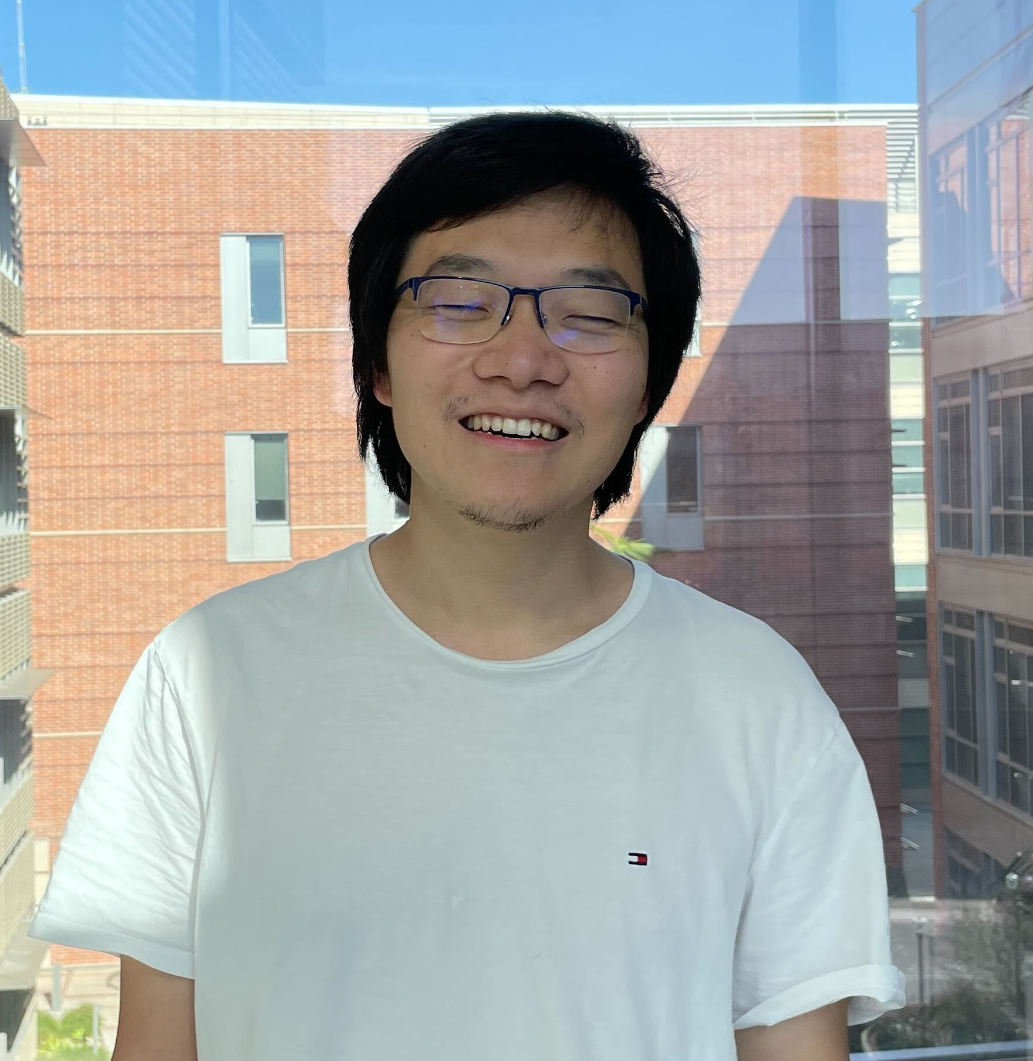


What’s in this tutorial?
Central Time
Introduction [1:00pm-1:30pm]
Decoupled-spatial paradigm and design space [DONE!]
Programming [1:30pm-2:30pm]
Pragma annotated interface
Visualizing compiler generated results
Hardware Overview [2:30pm-3:00pm]
Simulating generated binaries on generated RTL
Coffee Break [3:00pm-3:30pm]
Architecture Generation [3:30pm-4:15pm]
Scala DSL for ADG manipulation
Design Space Exploration [4:15pm-5:00pm]
Generating your own specialized accelerator
Jian Weng
Sihao Liu
Dylan Kupsh
Notes:
Here is a plan of our tutorial. I will spend another 1 hour for on programming interfaces and visualization.
Then my collaborator Sihao will take it, mostly on the hardware side.
Finally, my collaborator Dylan will demonstrate the design space exploration.

Slide 25
What’s not in the tutorial?
Programming the system from manual intrinsics.
But we do have manual programming SDK
dsa-apps/sdk/manual
riscv-dsa-ext/{intrin_impl.h, dsaintrin.h}
Extending the framework.
But we are willing to help.
Please contact us for specific concerns:
Compiler, ISA, Gem5: jian.weng@cs.ucla.edu
RTL, ADG, and FPGA: sihao@cs.ucla.edu
DSE, and Spatial Scheduler: dkupsh@cs.ucla.edu
Running code on the DSE-modified hardware.
Notes:
Because of the limited time, we cannot make you a full expert of our research infrastructure.
We still leave something for you to explore by yourselves.
If you have some specific concerns on the certain module, please feel free to contact us.

